Slide 1
Using SaaS patterns to accelerate multi-tenant SaaS application development on SQL Database Introducing the Wingtip SaaS sample app Bill Gibson Principal Program Manager, SQL Database

Slide 2
Topics
Data models for multi-tenant SaaS apps
Management and design patterns for SaaS
‘SaaS in a box’ sample app
Discussion - next steps, feedback

Slide 3
Multi-tenant SaaS database models
#1
Single-tenant
Every tenant gets its own DB
High
#2
#3
#4
#5
#1
#2
#3
#4
#5
#1
#2
#3
#4
#5
Tenant Isolation
1-99
100-199
200-299
Sharded Multi-tenant
Multiple tenants per DB, sharded across many DBs
Multi-tenant
All tenants in a single (large) database
Low
Notes:
Three main multi-tenant data models differ in the level of tenant isolation they afford. The choice of model normally has a significant impact on the application design, so is usually a fundamental architectural choice made early.
Shared-single multi-tenant database – all tenant data stored in single shared database, grows in size as tenant numbers grow.
Shared-sharded - distributes tenants across multiple databases or shards. Multiple tenants are stored in each shard, with the number of shards growing as tenants are added.
Database-per-tenant - isolates each tenant in their own database.
While the models are very different, what differs most fundamentally is the level of isolation between tenants…

Slide 4
Isolation pros and cons
Pros
Cons
Per-tenant management (security/privacy,
performance management, monitoring, index tuning,
auditing, schema customization, life-cycle management, etc.)
Over-provisioning -> high cost
Overkill for small data volumes
Database management at extreme scale
High
#1
#2
#3
#4
#5
#1
#2
#3
#4
#5
#1
#2
#3
#4
#5
Tenant Isolation
1-99
100-199
200-299
Supports extreme scale at low per-tenant data volumes
Lowest per-tenant cost
Coupled management (security, perf, etc.)
More complex total dev/ops solution
Cumbersome lifecycle management, etc.
Low

Slide 5
Hybrid model can blend benefits of MT/ST
Single-tenant
Every tenant gets its own DB
High
#23
#39
#144
#211
#265
split
Tenant Isolation
1-99
100-199
200-299
Sharded Multi-tenant
Multiple tenants per DB, sharded across many DBs
Multi-tenant
All tenants in a single (large) database
Low

Slide 6
Elastic pools provide cost-effective resource allocation for SaaS workloads
Hourly
share resources
Daily
Weekly
9:00
9:15
9:30
9:45
10:00
0:00
12:00
2017
2015
2016
23:59
Mon
Tue
Wed
Thu
Fri
Sat
Sun
Yearly
Elastic Pool
Individually unpredictable
Collectively stable and predictable
Expensive, must provision each db for peaks
Cost effective, scale pool up/down based on trends
Notes:
With an unpredictable tenant workload it’s by definition not practical to scale the resources up/down, you have to allocate resources to each database to handle peak workloads or sacrifice performance. The result:
Databases are overprovisioned for most of the time to handle peaks
Leads to high cost if databases are individually provisioned
The solution is to enable a group of databases to share a pool of resources – this pool can then behave much like the sharded or the shared database model, averaging out the moment-by-moment workload of individual tenants.
Workloads are averaged, and become…
Stable on a moment by moment basis, and predictable over longer periods of time.
Now its feasible to scale resources up and down to accommodate trends:
Daily cycles, scaling down overnight,
Weekly variation, scaling down over the weekend; as well as
Monthly and seasonal trends, scaling up for month-end reporting, tax year end, or peaks during holiday season, etc.

Slide 7
SaaS patterns address design and management complexity that occurs with large numbers of databases and/or tenants.

Slide 8
Patterns compose into E2E SaaS scenario
Tenant self service
GeoDR, AutoDR
Geo-restore
Reactive
Geo-replicate dbs for fastest recovery
Restore from geo-redundant backup
Tenant self service
Azure Automation
Pro-active
Azure Active Directory
Scheduled
Active/active cross-replication
Managed recovery of tenants at scale
PITR
Recover tenant data after tenant error
Authentication
Reactive
Handle intense isolated tenant workload
Pro-active
Elastic Jobs
SQL DW SQL DB + ColumnStore
Handle fluctuating aggregate workload
Geo-distributed tenant dbs
Azure Search
BCDR
Extract and analyze tenant data
Search
Scheduled
Database per Tenant
PowerBI
Azure Automation + ARM templates
Cross-Tenant Analytics
Manage performance
Query across tenant databases
Monitoring and alerting
ARM template, bacpac
Elastic Query
Elastic Pools
Manage schema change
Provision database and schema
Elastic Jobs
Portal + OMS
Catalog tenants and databases
Monitor app and data layer
Manage schema versioning via catalog
Auto-provision databases
Elastic database client library, Shard Management schema
Load-balance databases
Pre-provision databases to reduce tenant onboarding latency
Browse tenants
Connect app to tenant database
Manage extended tenant meta data

Slide 9
Patterns compose into E2E SaaS scenario
Tenant self service
GeoDR, AutoDR
Geo-restore
Reactive
Geo-replicate dbs for fastest recovery
Restore from geo-redundant backup
Tenant self service
Azure Automation
Pro-active
Azure Active Directory
Scheduled
Active/active cross-replication
Managed recovery of tenants at scale
PITR
Recover tenant data after tenant error
Authentication
Reactive
Handle intense isolated tenant workload
Pro-active
Elastic Jobs
SQL DW SQL DB + ColumnStore
Handle fluctuating aggregate workload
Geo-distributed tenant dbs
Azure Search
BCDR
Extract and analyze tenant data
Search
Scheduled
Database per Tenant
PowerBI
Azure Automation + ARM templates
Cross-Tenant Analytics
Manage performance
Query across tenant databases
Monitoring and alerting
ARM template, bacpac
Elastic Query
Elastic Pools
Manage schema change
Provision database and schema
Elastic Jobs
Portal + OMS
Catalog tenants and databases
Monitor app and data layer
Manage schema versioning via catalog
Auto-provision databases
Elastic database client library, Shard Management schema
Load-balance databases
Pre-provision databases to reduce tenant onboarding latency
Browse tenants
Connect app to tenant database
Manage extended tenant meta data

Slide 10
Patterns compose into E2E SaaS scenario
Tenant self service
GeoDR, AutoDR
Geo-restore
Reactive
Geo-replicate dbs for fastest recovery
Restore from geo-redundant backup
Tenant self service
Azure Automation
Pro-active
Azure Active Directory
Scheduled
Active/active cross-replication
Managed recovery of tenants at scale
PITR
Recover tenant data after tenant error
Authentication
Reactive
Handle intense isolated tenant workload
Pro-active
Elastic Jobs
SQL DW SQL DB + ColumnStore
Handle fluctuating aggregate workload
Geo-distributed tenant dbs
Azure Search
BCDR
Extract and analyze tenant data
Search
Scheduled
Multi-tenant Database
PowerBI
Azure Automation + ARM templates
Cross-Tenant Analytics
Manage performance
Query across tenant databases
Monitoring and alerting
ARM template, bacpac
Elastic Query
Elastic Pools
Manage schema change
Provision database and schema
Elastic Jobs
Portal + OMS
Catalog tenants and databases
Monitor app and data layer
Manage schema versioning via catalog
Auto-provision databases
Elastic database client library, Shard Management schema
Load-balance databases
Pre-provision databases to reduce tenant onboarding latency
Browse tenants
Connect app to tenant database
Manage extended tenant meta data
Notes:
The same fundamental requirements exist when working with a multi-tenant or hybrid single/multi-tenant databases. Solutions/patterns will be different.

Slide 11
Introducing “SaaS-in-a-box”
Sample SaaS app, deploys in Azure
Web app backed by SQL Database
Installs in under 5 minutes
Database-per-tenant with elastic pools
PowerShell management scripts
Analytics in SQL DB or SQL DW
Code, scripts, ARM templates on GitHub https://github.com/Microsoft/WingtipSaaS
Tutorials online https://aka.ms/sqldbsaastutorial
SaaS patterns that apply to any domain
Notes:
Explore scenarios, understand common SaaS requirements/challenges
Understand how patterns add value to PaaS platform regardless of domain
Leverage code samples, patterns, ideas to jump start development

Slide 12
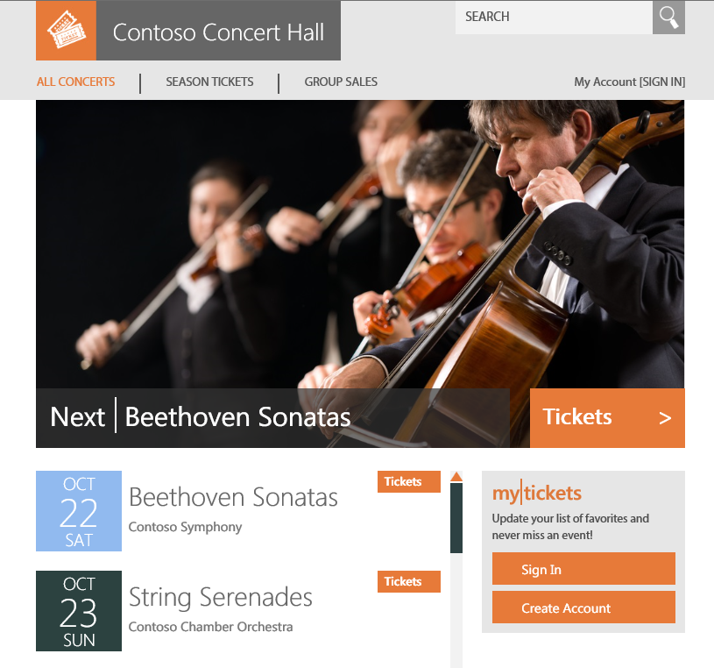
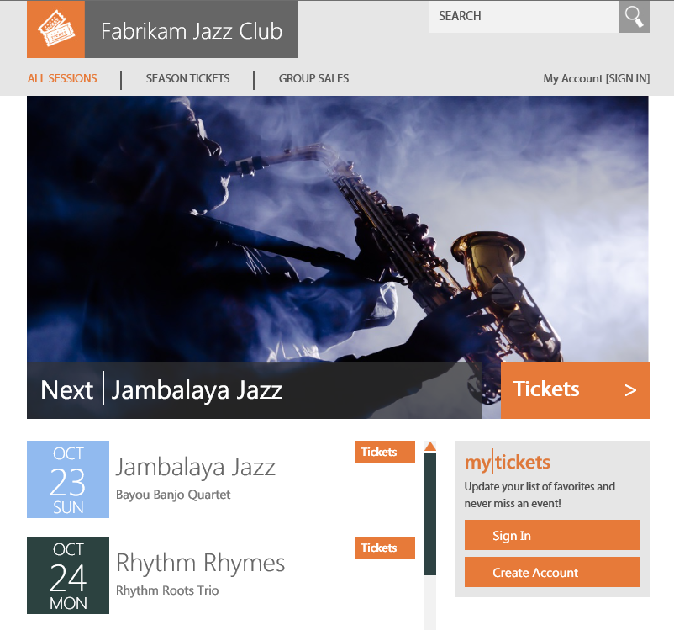
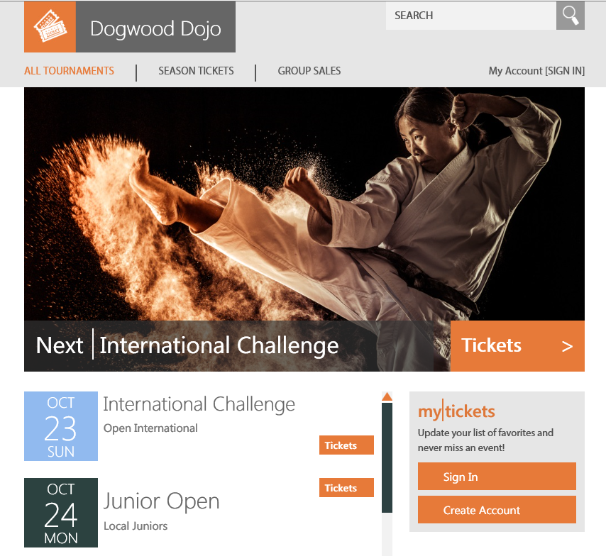
Wingtip SaaS application
Web app for small venues that host events and want to sell tickets
Each venue gets a customized experience, backed by their own database

Slide 13
Canonical database-per-tenant SaaS app
Scalable, load balanced
Apps
Tenant Catalog
Catalog
Holds mapping of tenants to databases plus tenant meta data
Data tier is scaled out by adding additional tenant databases
Tenant databases are hosted in elastic pools for cost effective resource sharing
Cust 1
Cust 2
Cust 3
Cust N
Tenant Databases

Slide 14
Wingtip SaaS app architecture
events.wtp.<user>.trafficmanager.net/<venue>
Web Apps
catalog-<user>
tenant
catalog
base tenantdb
job account
adhoc analytics
tenant analytics
tenant search
SQL DB/SQL DW
tenants1-<user>
Tenant 1
Tenant 2
Tenant 3
…
Notes:
The sample app extends the canonical pattern with additional management databases
- basetenantdb, used as golden template database for provisioning
- jobaccount, elastic jobs meta data store for managing jobs
- adhocanalytics, head database for Elastic Query, used to define schema for distributed query
- tenantanalytics,

Slide 15
demos
GitHub repo (incl. install link) https://github.com/microsoft/wingtipsaas
Tutorials https://aka.ms/sqldbsaastutorial
Getting started guide - installing and exploring the app https://docs.microsoft.com/en-us/azure/sql-database/sql-database-saas-tutorial
Blog post https://azure.microsoft.com/en-us/blog/saas-patterns-accelerate-saas-application-development-on-sql-database/

Slide 16
Exploring the patterns walkthroughs of several of the design and management patterns explored in the tutorials

Slide 17
Mapping tenants to databases
Apps
Catalog
Tenant Catalog
Cust 1
Cust 2
Cust 3
Cust N
Tenant Databases

Slide 18
Mapping tenants to databases
Tenant Onboarding
Application use
A. Customer signs up as new tenant
1. End user connects via a front end to the app
B. App provisions new tenant db
2. App looks up tenant in catalog via key
Apps
C. …registers tenant id, db name in catalog
3. …connects to correct tenant database
Tenant bacpac
Base TenantDB
SQL Database
Catalog
4. …on subsequent requests, uses cached database location
Tenant Catalog
Cust 1
Cust 2
Cust 3
Cust 4
Cust N
Elastic Data Client Library
Tenant Databases
Notes:
SQL Database provides a client library used in the cloud service, with a pro-forma Shard Management schema for the catalog, that together enable you to manage the tenant database mapping and to access this efficiently at runtime. Each tenant database provisioned also has a local copy of the shard management content that allows efficient cached connection management.
Client library is used in your app (here is represented by the green bar)
2 scenarios: onboarding a new tenant, normal application use
Onboarding
Can be automated as part of the application using API calls to the SQL Database service, optionally using ARM templates
Provisioning the database can be done by copy (as done in the sample) of by importing a bacpac. Either approach can be managed by direct API calls or by using an ARM template (ARM manages retry)
Application Use
The tenant signs in and the app uses the catalog to determine which database to connect to.
Using the client library, the app will construct a connection to enable app connection to the correct database. The client library, the catalog and the tenant database the user
The client layer

Slide 19
Managing unpredictable tenant workloads
1. Provisioning service creates pool
2. …pre-provisions databases
3. As tenants register they are assigned databases
Apps
4. Service pre-provisions next pool and databases
5. Scale pool to handle more load/databases
SQL Database
Catalog
6. Move databases between pools to load-balance pools
7. Databases can be moved out if they become very active
pool1
pool2
pool3
Cust 4
Cust 17
Cust 1
Cust 2
Cust 3
Cust 10
Cust 11
Cust 12
Cust 13
Notes:
Managing the provisioning and placement of databases in pools is key to effectively managing resources and ensuring the solution is manageable for large numbers of tenants.
Create a new pool ready for new databases
Create new databases directly in the pool. As you pay only for the pool not the databases, its efficient to pre-create databases for tenants.
Reduces onboarding time,
Ensures databases are fully backed up before you start putting customer data in them.
Increase pool size (resources allocated to it) to support more databases or more activity
Load balance by moving databases between pools
Move database out of pool if it becomes more active and is more cost effective as a stand-alone db
All the pool and database creation and management actions can be invoked from the app allowing automated resource management

Slide 20
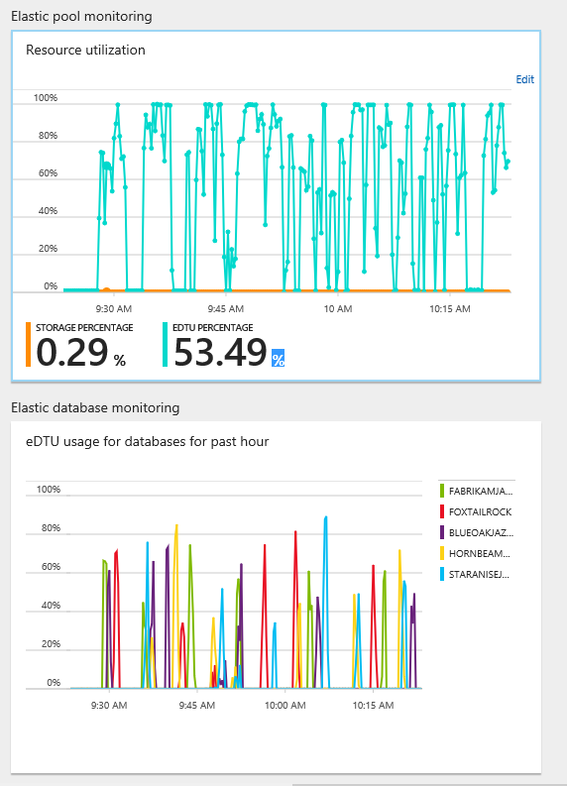
Elastic Pool and Database Monitoring

Slide 21
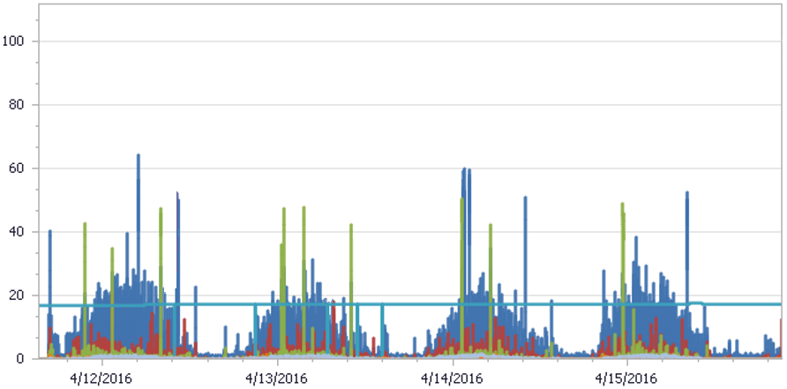
Elastic pool usage profile
Actual usage from an accounting SaaS app
400 dbs in 200 DTU pool, per-database max at 100 DTUs
Notes:
Real telemetry from an accounting customers set of pools (when this data was recorded they had over 300 pools, and each pool had nearly 400 databases sharing 200 DTUs).
The tenant workload is easily able to run in one pool.
[The pool at 200 DTUs is twice the per-database max of 100 DTUs so would allow 2 databases to be active]
So how do we incorporate elastic pools into app and what are the interesting design patterns…?

Slide 22






Distributed query across tenant databases
Query all tenants as if they are in a single database
PowerBI
Apps
Query from any client
Database locations are retrieved from catalog
Elastic Query
Catalog
Adhoc Analytics
External tables project data from tenant dbs
Tenant Catalog
Cust 1
Cust 2
Cust 3
Cust 4
Cust N
Distributed query plan
Tenant Databases
Notes:
As a SaaS vendor there are many reasons to want to look across your set of tenant databases.
This viewpoint lets you learn about your customers and how they use your service.
To do this we need to distribute queries across all the databases
Elastic query provides a way to do this, enabling, fanout of queries to each database.
A head database is created and this is then mapped to remote
It uses the catalog to describe the scope of the query, and then creates a distributed

Slide 23
Schema management at scale
Manage 1000s of databases as one
Azure Portal
Apps
T-SQL
CREATE TABLE…
CREATE INDEX…
INSERT INTO…
SELECT * FROM…
T-SQL Job
SELECT * FROM…
Job Account
Catalog
Tenant Catalog
Cust 1
Cust 2
Cust 3
Cust 4
Cust N
Elastic Jobs
T-SQL
T-SQL
T-SQL
T-SQL
T-SQL
Tenant Databases

Slide 24
Extract tenant data into an analytics DB or DW
Unlock operational and application insights
PowerBI
Azure Portal
Apps
Query from any client
T-SQL
CREATE TABLE…
CREATE INDEX…
INSERT INTO…
SELECT * FROM…
T-SQL Job
SELECT * FROM…
Job Account
Catalog
Adhoc Analytics
Tenant Analytics
Tenant Catalog
SQL DB with ColumnStore or SQL DW
Cust 1
Cust 2
Cust 3
Cust 4
Cust N
Elastic Jobs
T-SQL
T-SQL
T-SQL
T-SQL
T-SQL
Tenant Databases
Notes:
As a SaaS vendor there are many reasons to want to look across your set of tenant databases.
This viewpoint lets you learn about your customers and how they use your service.
To do this we need to distribute queries across all the databases
Elastic query provides a way to do this, enabling, fanout of queries to each database.
A head database is created and this is then mapped to remote
It uses the catalog to describe the scope of the query, and then creates a distributed

Slide 25
Tenant database recovery…
0. Oops! Tenant user accidentally deletes or corrupts data in their tenant database.
Apps
Catalog
Cust 1
Cust 2
Cust 3
Cust N

Slide 26
Tenant database recovery: in parallel
Azure Storage
0. Oops! Tenant user accidentally deletes or corrupts data in their tenant database.
Apps
1. End user requests access to a parallel copy of their data at an earlier point.
SQL Database
Catalog
2. Restore from backup is triggered to create a new parallel database.
Luckily, database transaction logs are automatically backed up and retained for 35 days…!
3. Catalog is updated to register the restored database and enable access.
Cust 1
Cust 2
Cust 3
Cust 3 _old
Cust N
4. End user connects to app which offers read-only access to restored database alongside current database
Notes:
Service exposes all management actions via APIs, with client libraries
This enables SaaS apps to integrate common management actions. In this case this can enable tenant self-service recovery from accidental data loss or corruption
(SaaS app could implement parallel data space to allow a user to review past data)
LTR will provide longer term archival of weekly backups, still with self-service recovery

Slide 27
Tenant database recovery: in-place
Azure Storage
0. Oops! Tenant user accidentally deletes or corrupts data in their tenant database.
Apps
1. End user requests in-place recovery to an earlier point
Cust 3
Catalog is updated to mark tenant offline then old database is deleted.
SQL Database
Catalog
Restore is triggered
Luckily, database transaction logs are automatically backed up and retained for 35 days…!
After restore is complete catalog is updated to mark tenant online
Cust 1
Cust 2
Cust 3
Cust 3
Cust N
5. End user connects to restored database as normal. Phew!
Notes:
Service exposes all management actions via APIs, with client libraries
This enables SaaS apps to integrating common management actions. In this case this can enable customer self-service recovery from accidental data loss or corruption
(SaaS app could implement parallel data space to allow a user to review past data)
LTR will provide longer term archival of weekly backups, still with self-service recovery

Slide 28

Enable search over distributed tenant data
Azure Search
Apps
Tenant Catalog
Search
Catalog
Search database
Projects indexable data from all tenants
Cust 1
Cust 2
Cust 3
Cust 4
Cust N
Tenant Databases

Slide 29
Resources
Blog post https://azure.microsoft.com/en-us/blog/saas-patterns-accelerate-saas-application-development-on-sql-database/
GitHub repo https://github.com/microsoft/wingtipsaas
Tutorials https://aka.ms/sqldbsaastutorial
Getting started guide - installing and exploring the app https://docs.microsoft.com/en-us/azure/sql-database/sql-database-saas-tutorial

